Slide 1
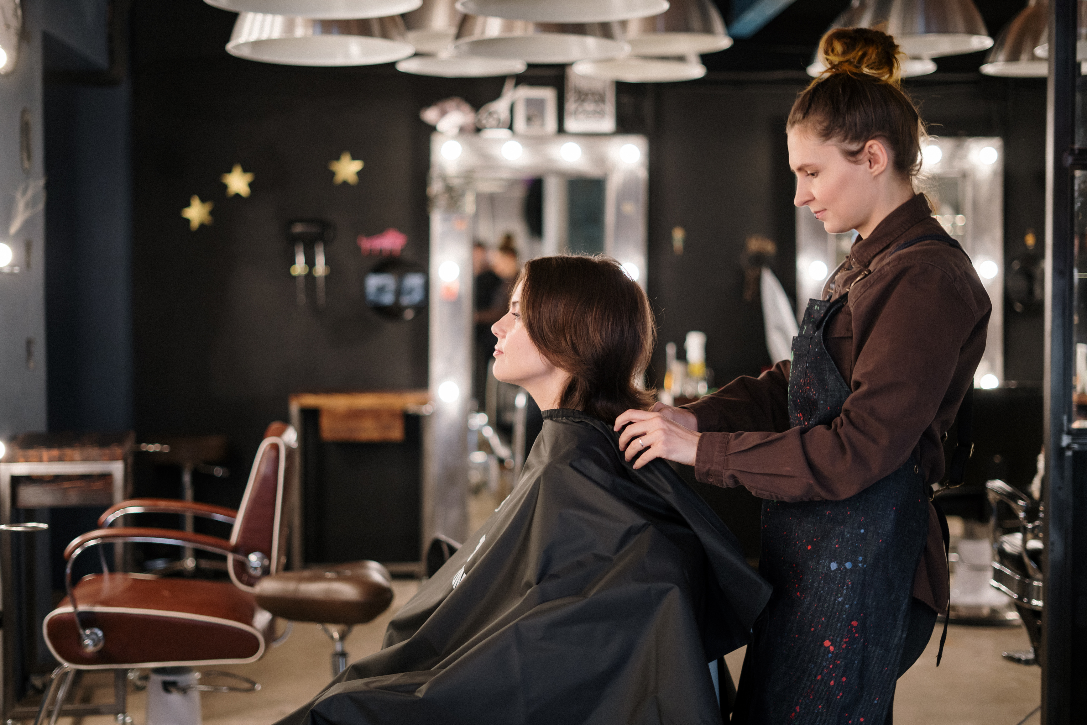


THE GLAMOUR
Crafting Elegance,
One Look at a Time.

Slide 2
Major Functionalities
Appointment Booking: This feature allows users to schedule appointments conveniently through our website. It should include a calendar view, available time slots, and confirmation notifications to ensure efficient scheduling.
Product Selling: Our website's e-commerce capabilities should enable users to browse, select, and purchase products easily. This requires a user-friendly interface, a secure payment gateway, and a reliable inventory management system to handle transactions smoothly.
Review System: Implementing a review feature allows customers to share their feedback and experiences with our products or services. This can enhance credibility and help potential buyers make informed decisions.
Payment Processing: Secure and efficient payment processing is vital. Offer multiple payment options like credit/debit cards, PayPal, or other digital wallets to cater to diverse customer preferences while ensuring the safety of their financial information.
Mail Notifications: Automated email notifications can keep users informed about their appointments, order confirmations, shipment tracking, and any updates or promotions. This helps maintain engagement and enhances customer satisfaction.

Slide 3


WHAT WE ARE PROVIDES
Makeup: Enhancing beauty with professional makeup techniques for all occasions.
Hairstyling: Trendy cuts, styling, and treatments to suit every personality and event.
Facials: Skin-nourishing treatments for a glowing, refreshed, and healthy complexion.

Slide 4
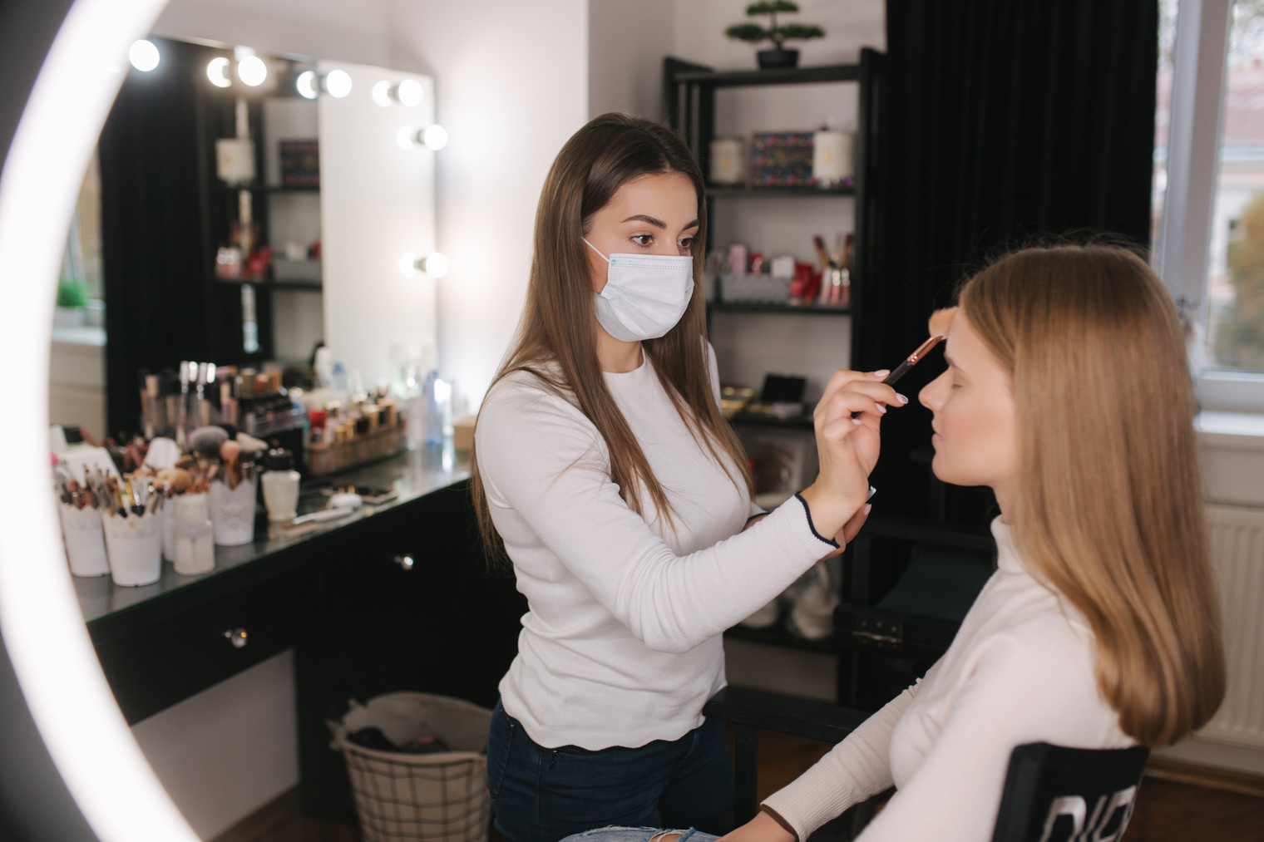
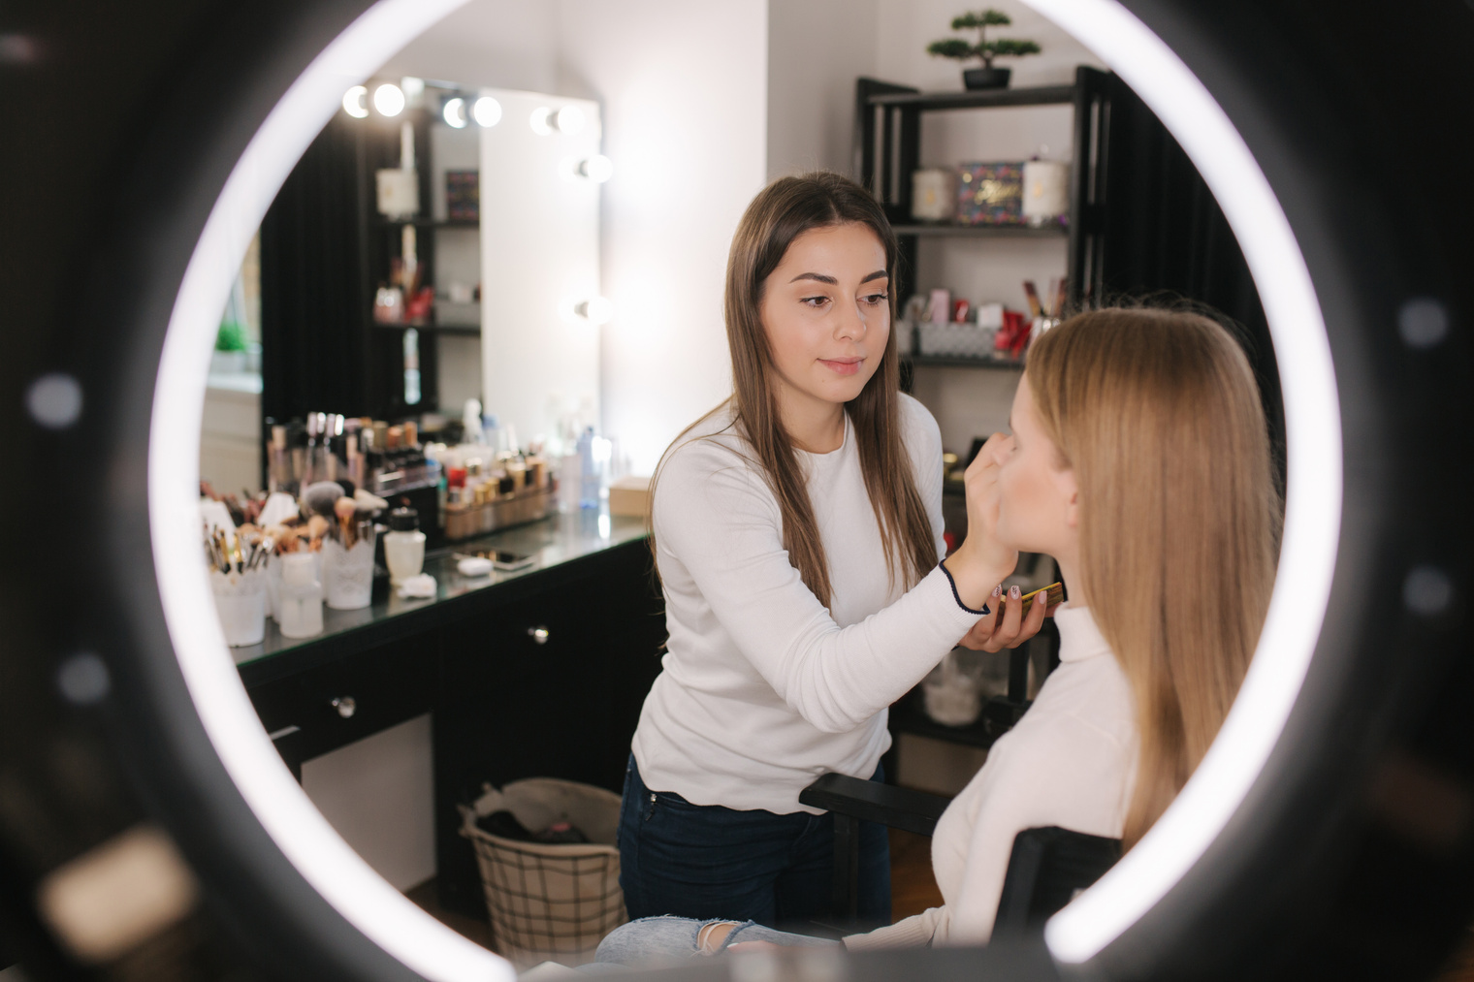


Our Services
Bridal Makeup: Flawless and long-lasting bridal looks for your special day.
Occasion Makeup: Elegant makeup for parties, events, and professional shoots.
Hairstyling: Trendy cuts, styling, and treatments to enhance your look.
Facial Treatments: Rejuvenating facials for a healthy and glowing complexion.
Nail Art: Creative nail designs with stylish patterns and colors.
Haircut & Spa: Professional haircuts with relaxing spa treatments for nourishment.
Mehndi Designs: Beautiful henna artistry for weddings and festive occasions.

Slide 5
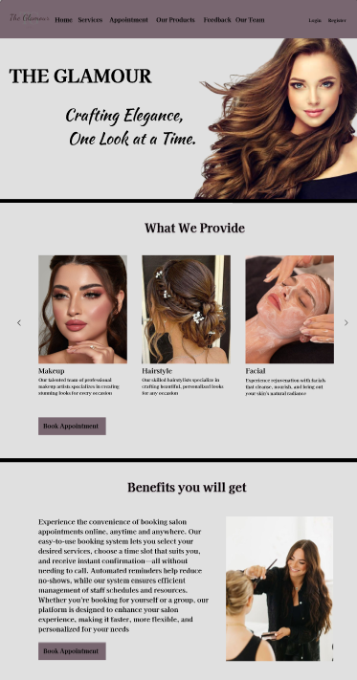
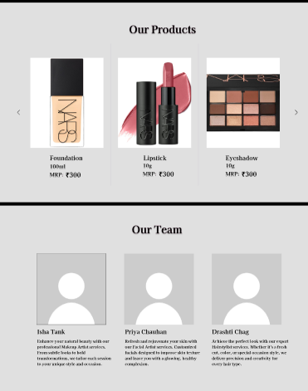
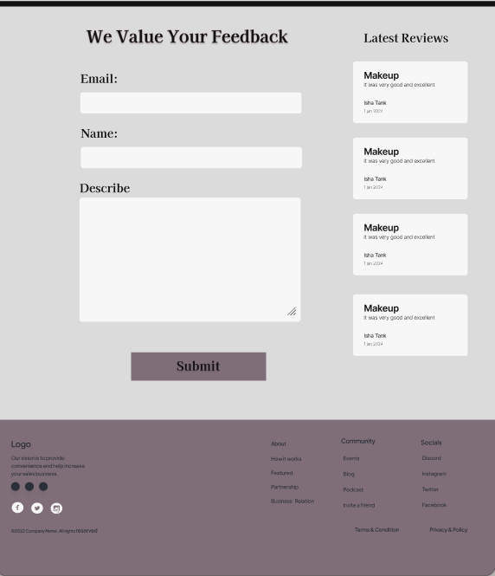
figma design - User Side
Welcome to The Glamour - your one-stop destination for beauty treatments and services, crafted to meet your needs with excellence and innovation. Explore our offerings and discover the solutions that await you!

Slide 6
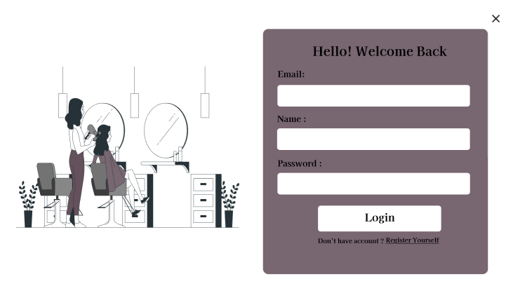
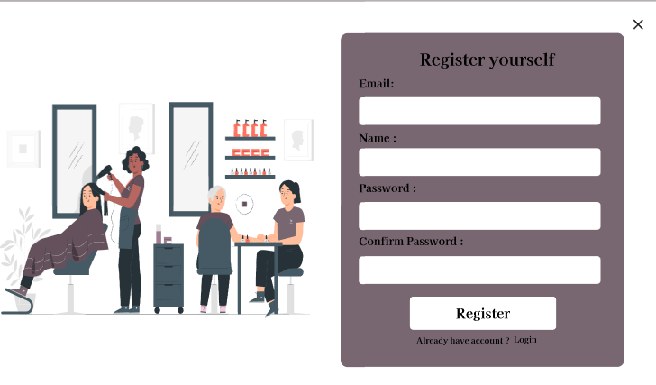
figma design - User Side
This is our login page
This is our Register page

Slide 7
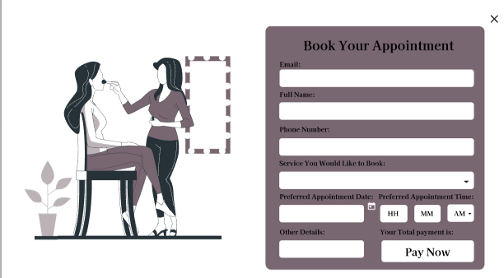
figma design - User Side
The Book Appointment feature allows customers to select a service, and pick a date and time from available slots. Users can confirm the booking by providing their details and optionally making an online payment. They receive a confirmation via email, and admins can manage appointments, send reminders, and track booking history.

Slide 8
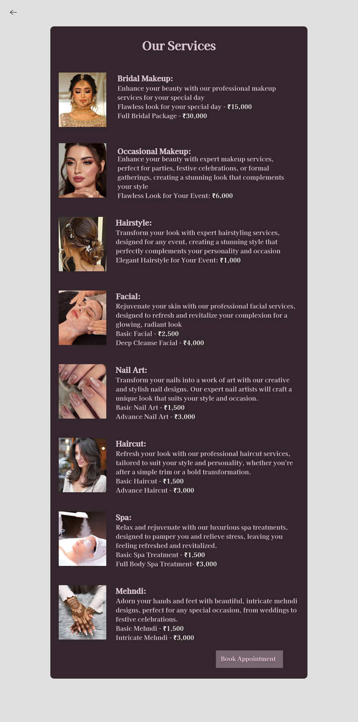
figma design - User Side
This is our all services details page , when user clicks on any of the carousel card of services , this page will open. user can see what price is for which service.

Slide 9
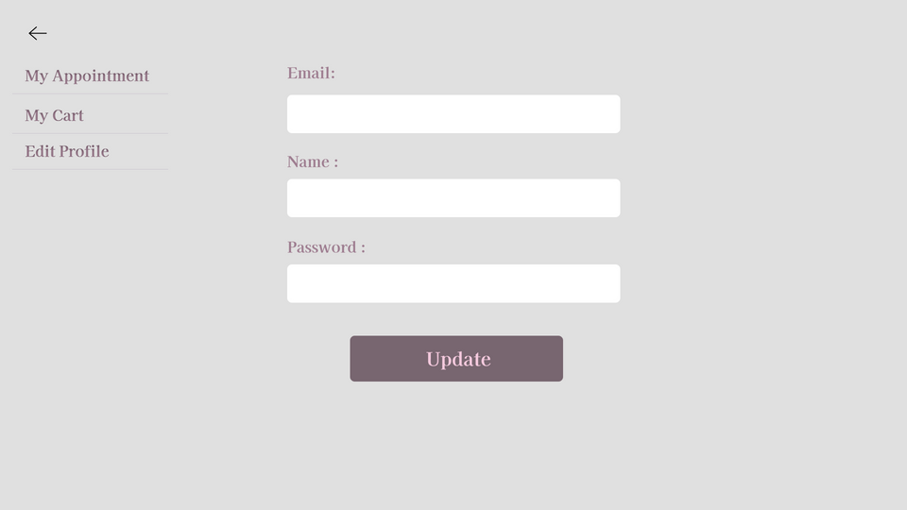
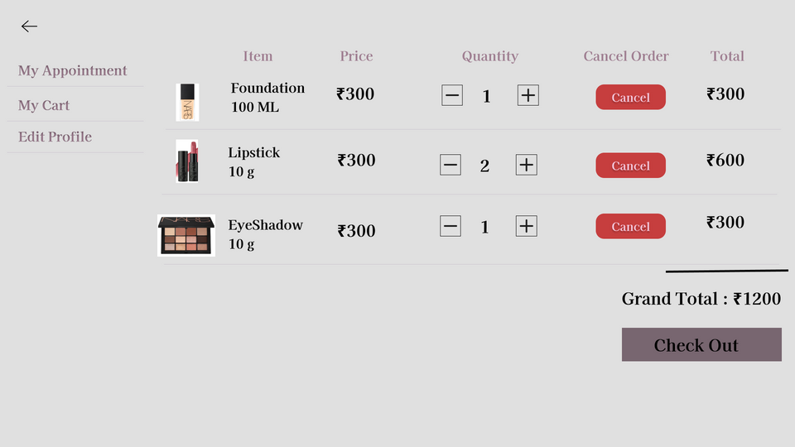
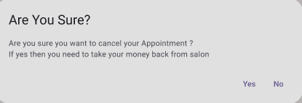
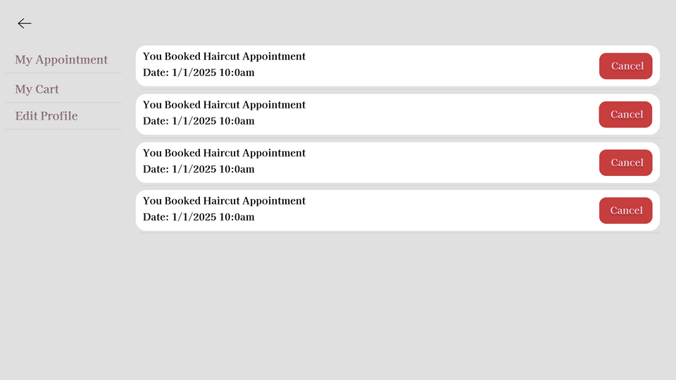
figma design - User Side
The "My Profile" feature enhances user experience by integrating "My Appointment," "My Cart," and "Edit Profile." Users can easily manage appointments, review shopping items, and update personal information, creating a seamless and personalized interface. This fosters greater engagement and satisfaction.

Slide 10
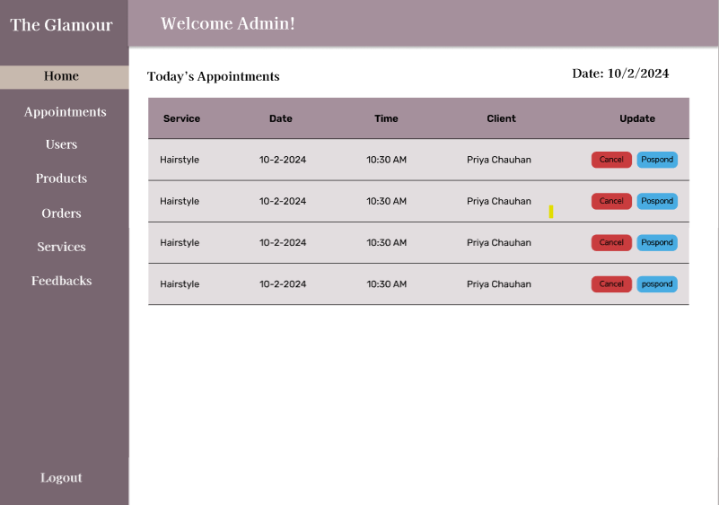
figma design - Admin Side
This is the home page of Admin Side.
Admin can see today’s appointment in home page.

Slide 11
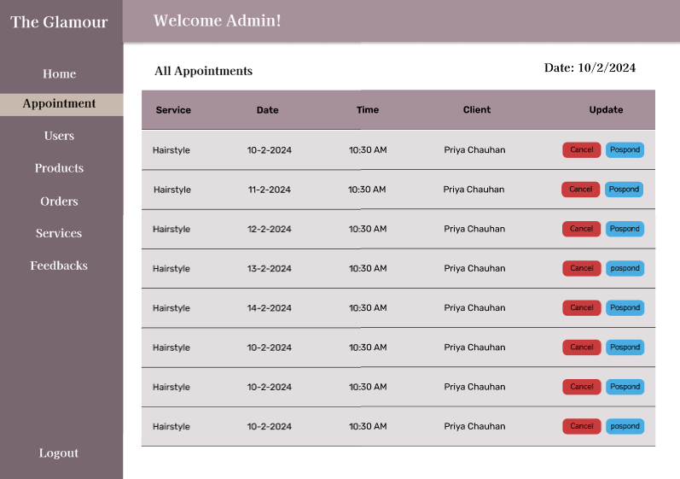
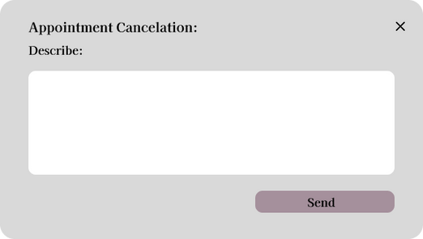
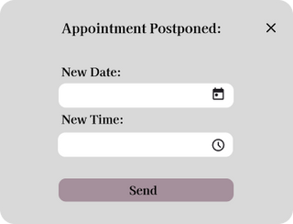
figma design - Admin Side
This is all Appointments Page , Admin can cancel or postpone any Appointment and it will open an popup and it will allow Admin to write reason for cancelling appointment or postponing appointment, it allows admin to set new date and time for new postponed appointment

Slide 12
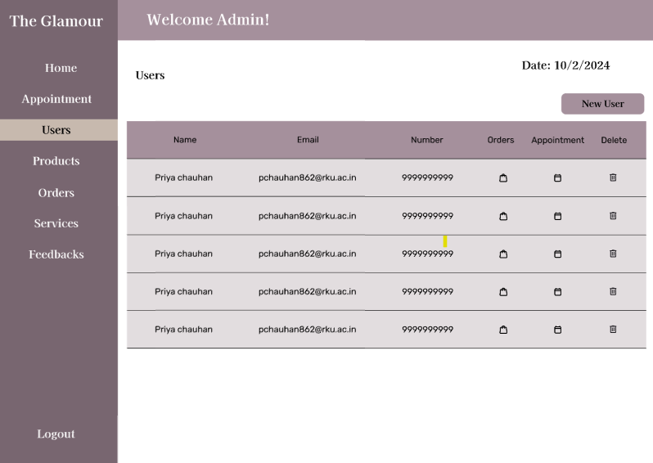
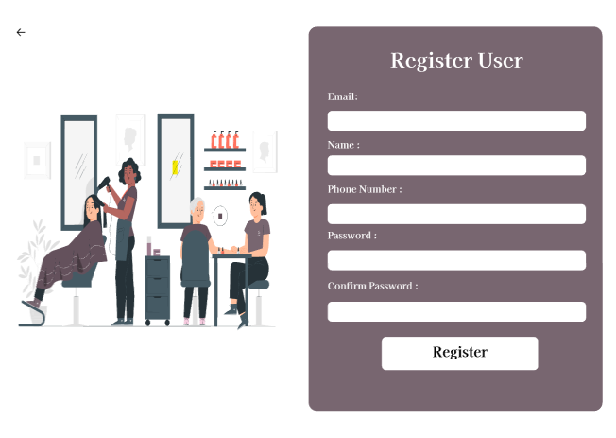
figma design - Admin Side
This is our Users page.
It displays all user details , Admin can see activity of each user and can delete each user.
Admin can register user also.

Slide 13
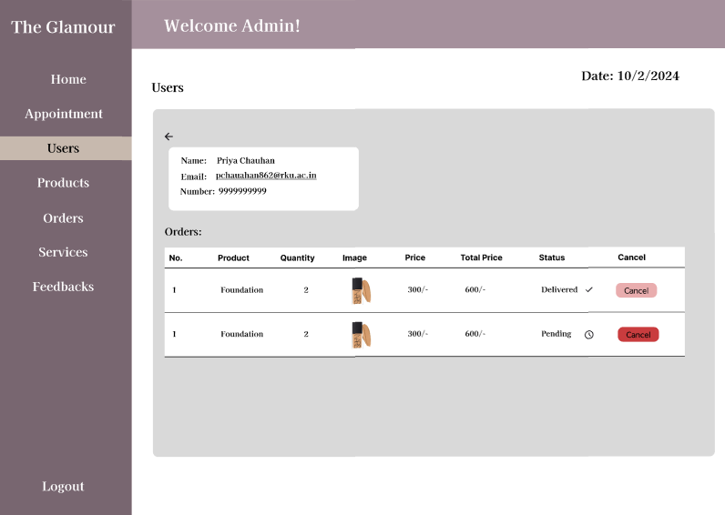
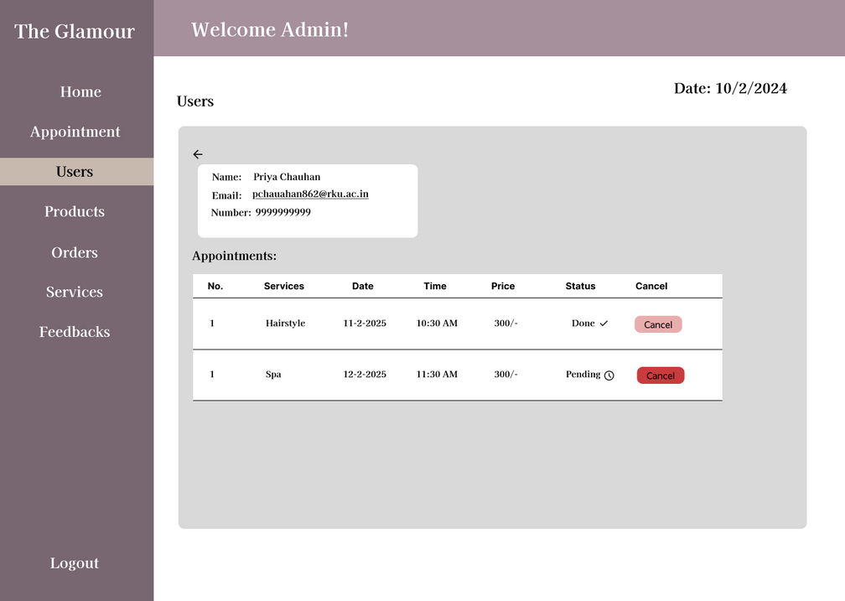
figma design - Admin Side
This is how admin can see activity of each user ,
what they ordered and if they booked any Appointment of not

Slide 14
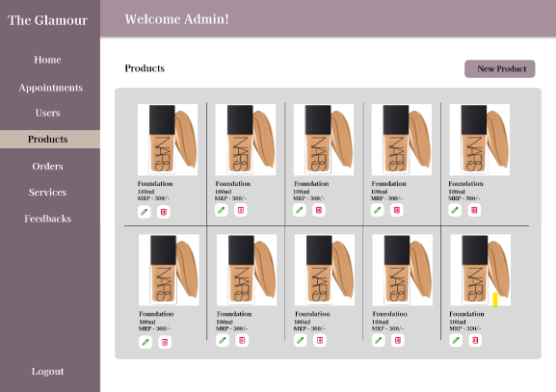
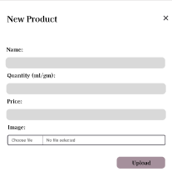
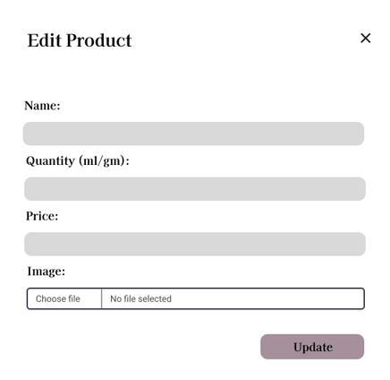
figma design - Admin Side
This section allows the admin to monitor user Products, including their New Products adding and editing.

Slide 15
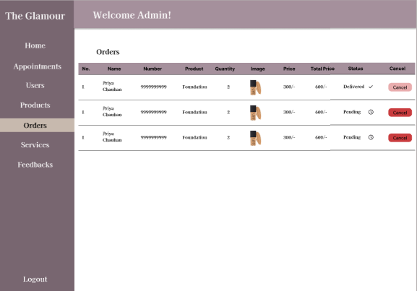
figma design - Admin Side
This section displays user orders along with their names and timestamps. Orders are categorized as Delivered or Pending for easy tracking.

Slide 16
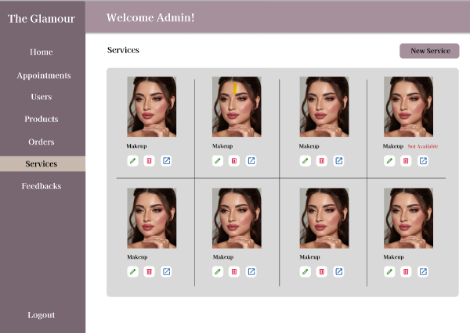
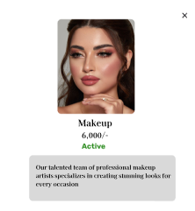
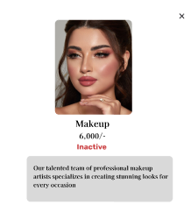
figma design - Admin Side
This section allows the admin to manage services, including adding, editing, deleting, and viewing services, as well as setting them to Active or Inactive.

Slide 17
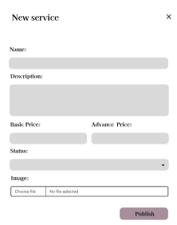
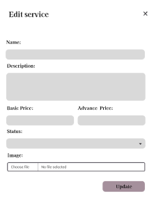
figma design - Admin Side
This page allows the admin to add new services and edit existing ones, including setting them
as Active or Inactive." text

Slide 18
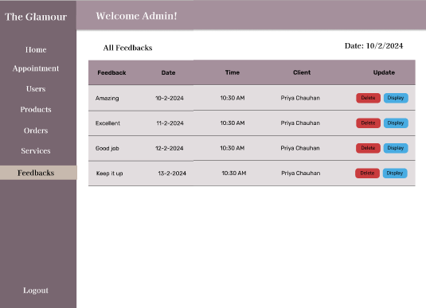
figma design - Admin Side
This section displays Feedback of any product or services. Admin can decide which feedback should be displayed on user side.

Slide 19
Meet Our Team
Priya Chauhan - 22SOECE11008
Roll No =9
CE-A
Drashti Chag - 22SOECE11007
Roll No =8
CE-A
Isha Tank - 22SOECE11056
Roll No =53
CE-A

Slide 20

THANK YOU

